Slide 1


K.RAMAKRISHNAN COLLEGE OF TECHNOLOGY (AUTONOMOUS), TRICHY
STOCK PORTFOLIO SYSTEM
PRESENTED BY
Keerthiga T
2303811710622052

Slide 2
PRESENTATION OVERVIEW
PROJECT INTRODUCTION
PROJECT OBJECTIVE
PROBLEM STATEMENT
LIBRARIES USED
EXISTING SYSTEM
PROPOSED SYSTEM
BLOCK DIAGRAM
MODULE DESCRIPTION
CONCLUSION AND FUTURE ENHANCEMENT

Slide 3
PROJECT INTRODUCTION
Introduction:
The Stock Portfolio System is designed to assist investors in tracking and managing their investments efficiently. This system offers comprehensive insights into stock performance, portfolio diversification, and financial analysis, enabling users to make informed decisions. By integrating real-time data and advanced analytical tools, the Stock Portfolio System aims to enhance the investment experience, providing a robust platform for both novice and experienced investors.

Slide 4
PROJECT OBJECTIVE
Objective:
The objective of the Stock Portfolio System project is to develop a comprehensive tool that facilitates the effective management of investment portfolios. This system aims to provide real-time tracking of stock performance and portfolio value, offer detailed financial analysis to help users understand market trends, and enhance portfolio diversification to minimize risks. Additionally, it aims to deliver insightful reports and visualizations that assist users in monitoring their investments and identifying opportunities for growth.

Slide 5
PROBLEM STATEMENT
1. Import and manage historical and real-time financial data for a wide range of stocks, including price, volume, dividends, and corporate actions.
2. Construct and customize diversified portfolios based on user-defined criteria such as risk tolerance, investment goals, and sector preferences.
3. Implement various quantitative techniques and algorithms to analyze stock performance, identify trends

Slide 6
LIBRARIES USED
The Stock Portfolio System project utilizes the following libraries:
1.⁠ ⁠Pandas: Data manipulation and analysis.
2.⁠ ⁠NumPy: Numerical operations and computations.
3.⁠ ⁠Matplotlib & Seaborn: Data visualization.
4.⁠ ⁠yahoo finance API : Accessing historical market data.

Slide 7
EXISTING SYSTEM
Before the Stock Portfolio System, individual investors often relied on spreadsheets or basic online tools to manage their portfolios. These solutions lacked real-time data updates, sophisticated analysis capabilities, and user-friendly interfaces, making it challenging for investors to make informed decisions.

Slide 8
DISADVANTAGES OF EXISTING SYSTEM
Limited analysis
Poor user interface
Limited integration
Lack of real time data

Slide 9
PROPOSED SYSTEM
The proposed Stock Portfolio System aims to revolutionize investment management by offering a comprehensive platform that addresses the limitations of existing solutions. By providing real-time data updates, advanced analytics, and an integrated platform, investors will have access to up-to-date information, sophisticated analysis tools, and a streamlined user experience.

Slide 10
ADVANTAGES OF PROPOSED SYSTEM
Real time data updates
User friendly interface
Advanced analytics
Security measures
Performance efficiency

Slide 11
BLOCK DIAGRAM
Start
Input: Add
Input:
Remove
Input:
Value
End
Initialize stock object
Output:
Value
Input:
Display

Slide 12
Module Description
User Input
⁠Data Retrieval
⁠Stock Class Initialization

Slide 13
User input module
The module starts by requesting the user to input the ticker symbol (e.g., AAPL), start date (YYYY-MM-DD), and end date (YYYY-MM-DD) for the historical stock data they want to analyse.

Slide 14
Data retrieval
Data retrieval in the Stock Portfolio System module involves several key steps. First, the module identifies the data source, utilizing the Yahoo Finance API accessed through the ⁠⁠ Python module.

Slide 15
Stock class initialization module
The ⁠ Stock ⁠ class initialization in the Stock Portfolio System module is crucial for setting up the retrieval and management of stock data. It begins by defining the parameters required for initialization, including the stock symbol (⁠ symbol ⁠), start date (⁠ start_date ⁠), and end date (⁠ end_date ⁠) for the data retrieval period

Slide 16
CONCLUSION AND FUTURE ENHANCEMENT
In conclusion, the ⁠ Stock ⁠ class initialization is a critical component of the Stock Portfolio System module, enabling the retrieval and management of historical stock price data. By defining parameters such as the stock symbol and date range, initializing the class sets the stage for accessing relevant stock market information. Leveraging the ⁠ yfinance ⁠ module, the class efficiently downloads and stores this data for later analysis.

Slide 17
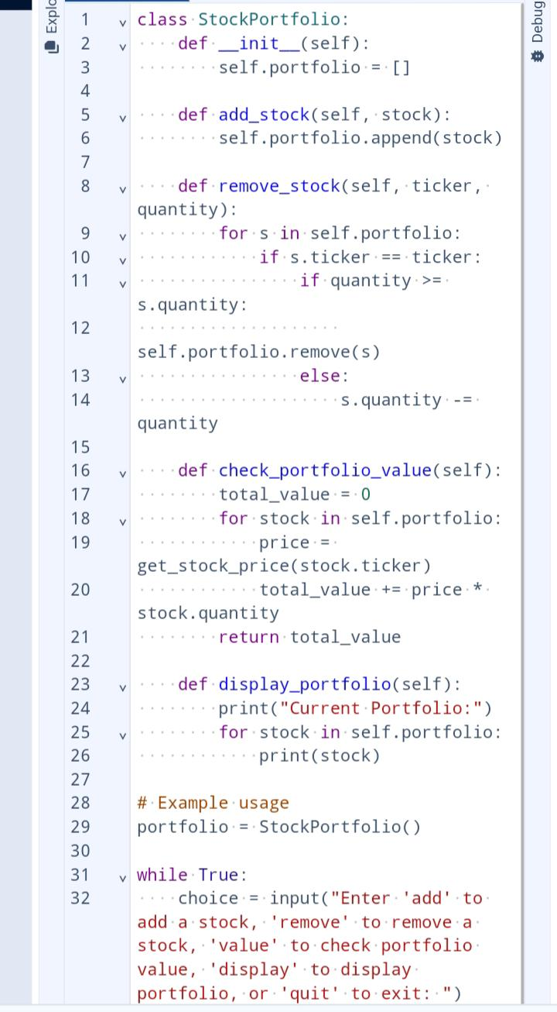
SCREENSHOT

Slide 18
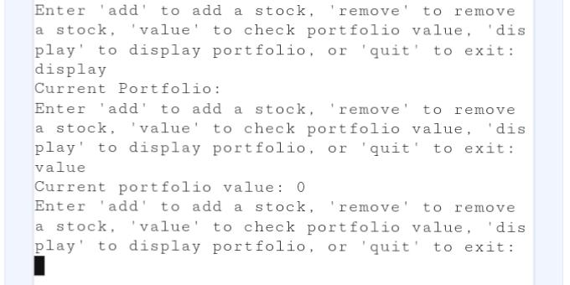
OUTPUT SCREENSHOT

Slide 19
THANK YOU

